Slide 1

Introduction to Machine Learning
Module 1: Foundations, Definitions, and Taxonomy

Slide 2


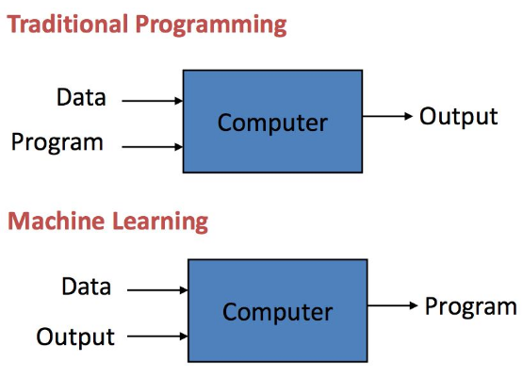

What is Machine Learning?
•
Field of study giving computers the ability to learn from data without explicit programming.
•
A subset of Artificial Intelligence (AI).
•
Algorithms improve performance through Experience (E).
Key Shift: The machine generates the rules (model) by observing patterns, rather than humans defining every rule.

Slide 3
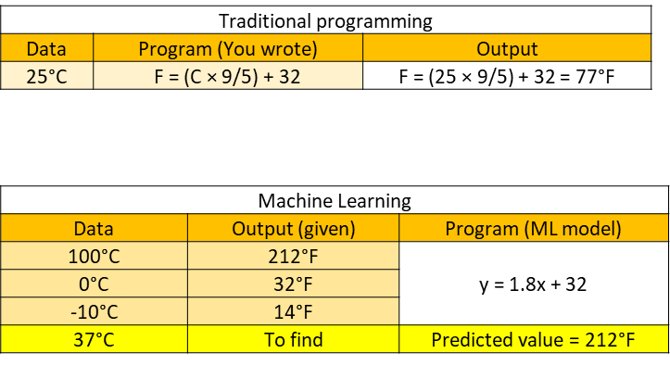

Slide 4
Need for Machine Learning
ML is used when:
•Human expertise does not exist (navigating on Mars)
•Humans can’t explain their expertise (Biometrics)
•Models must be customized (personalized medicine)
•Learning isn’t always useful:
•There is no need to “learn” to calculate payroll

Slide 5
Need for Machine Learning
ML is used when:
•Human expertise does not exist (navigating on Mars)
•Humans can’t explain their expertise (Biometrics)
•Models must be customized (personalized medicine)
•Learning isn’t always useful:
•There is no need to “learn” to calculate payroll

Slide 6
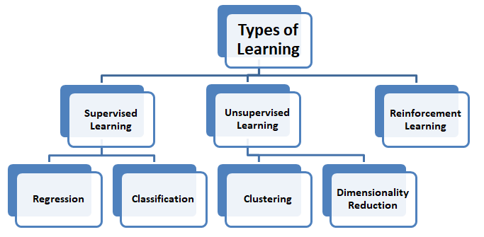
Taxonomy of Machine Learning
Three Core Types
•
Supervised Learning: Uses labeled inputs (data + known outputs).
•
Unsupervised Learning: Uses unlabeled data; learns hidden patterns.
•
Reinforcement Learning: Uses delayed feedback (rewards) based on actions.

Slide 7
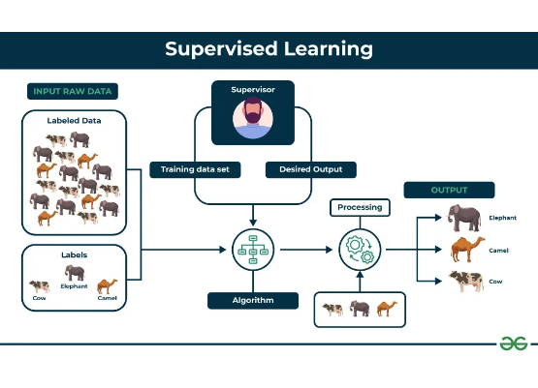
Supervised Learning Overview
•
Goal: Learn a function f ( x ) mapping inputs to outputs.
•
Training set contains paired examples:
( x 1 , y 1 ) ... ( x n , y n ) .
•
Process is "supervised" by knowing the correct label (target) for each example.
Example: Predicting voter preference based on age and location.

Slide 8
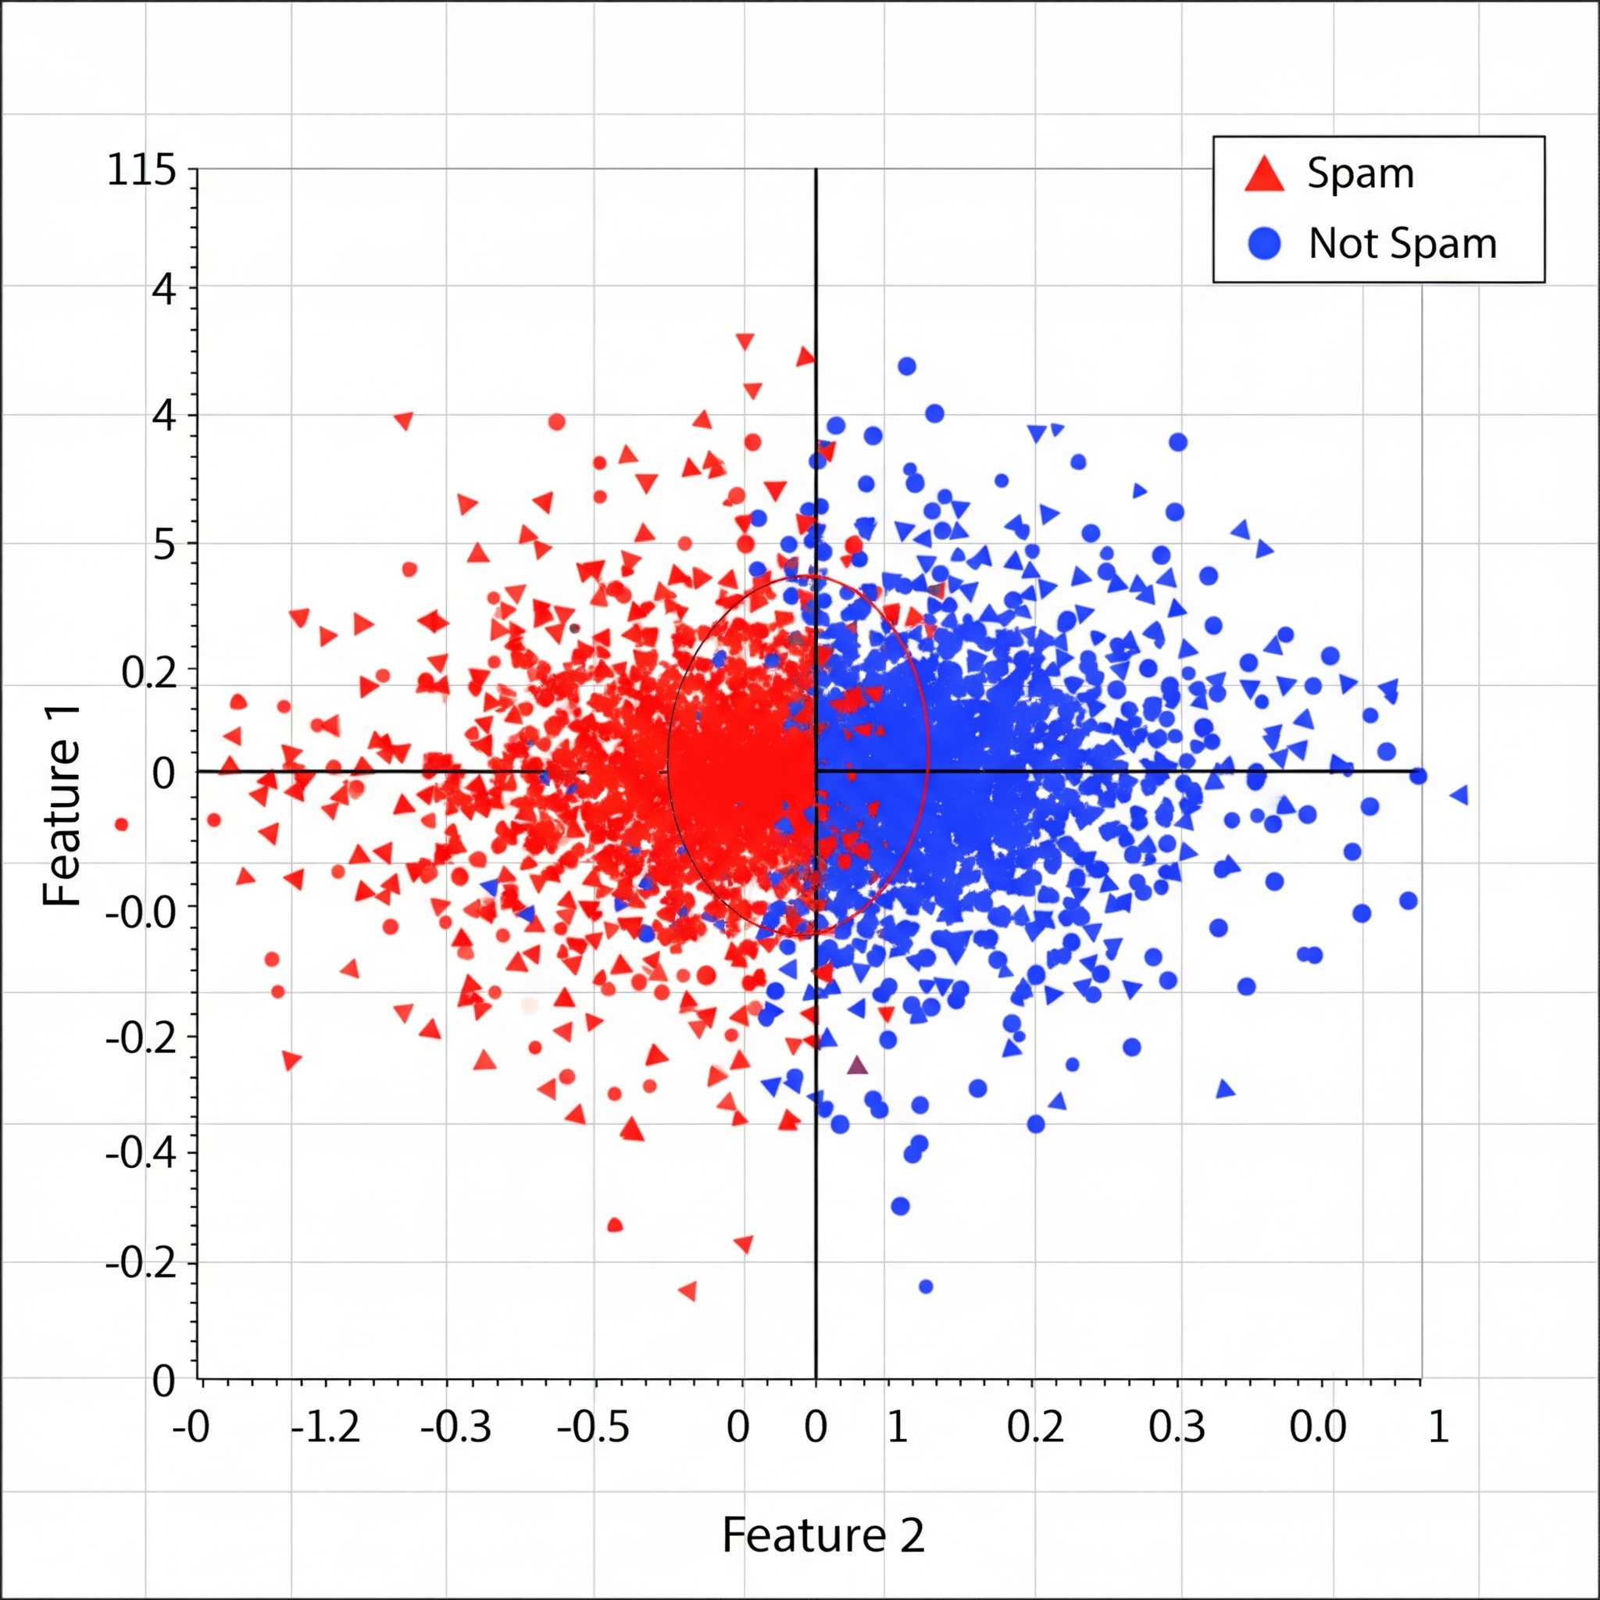
Task 1: Classification
Predicting Discrete Labels
•
The output variable y is a discrete category.
•
Binary: Two classes (e.g., Spam / Not Spam).
•
Multiclass: >2 classes (e.g., Cat / Dog / Lizard).
•
Objective: Draw a boundary (hyperplane) to separate groups.

Slide 9
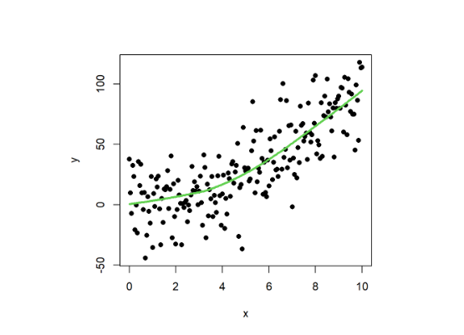
Task 2: Regression
Predicting Continuous Values
•
The output y is a real number (continuous).
•
Goal: Fit a function to model the trend (e.g., stock price, temperature).
•
Minimize error (e.g., Sum of Squared Error) between predicted and true values.

Slide 10
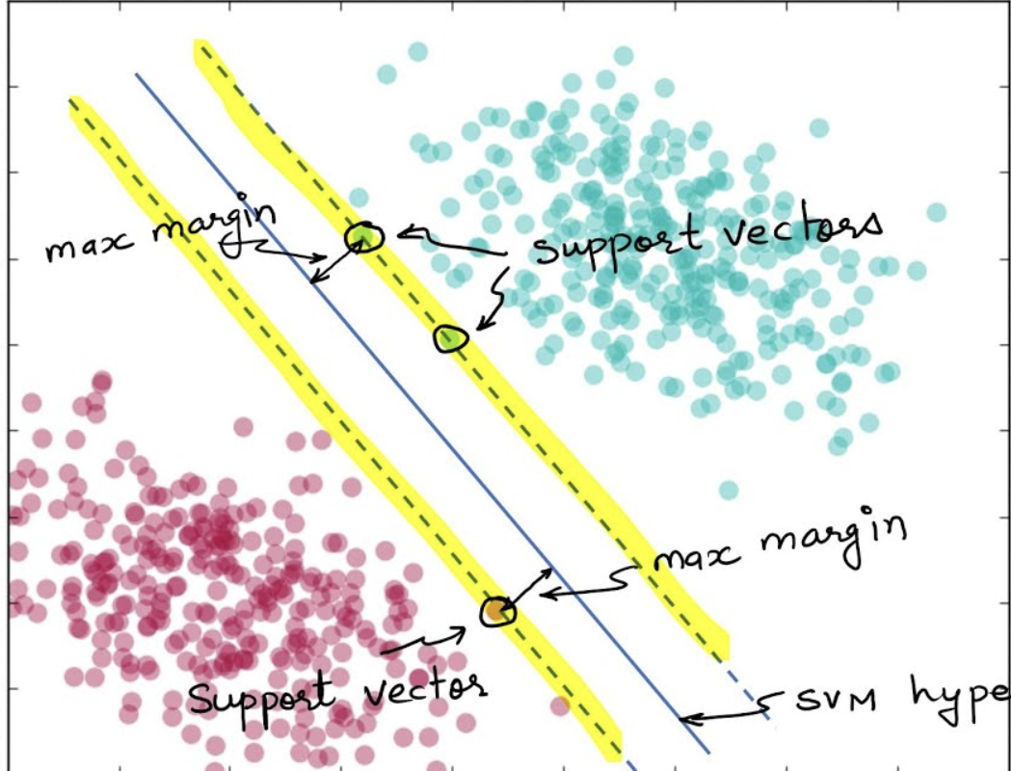
Supervised Learning Techniques/Algorithms
•
Linear Regression: Fits straight line/plane to minimize error.
•
Logistic Regression: Estimates probability for classification.
•
Support Vector Machines (SVM): Finds maximal margin hyperplane to separate classes. Effective in high dimensions.
•
Decision Trees: Sequence of binary splits; highly interpretable.
•
Naïve Bayes: Probabilistic classifier assuming feature independence.

Slide 11
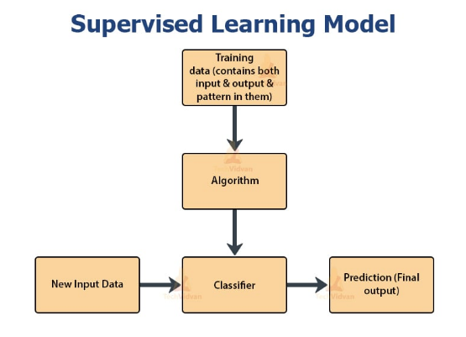
Supervised Learning Workflow
1.
Training: Input labeled data ( X , Y ) into algorithm.
2.
Learning: Generate a Learned Model (Hypothesis).
3.
Inference: Feed unseen data X ' to model to get Prediction Y ' .
Loop: Inference comes from experience gained during training.

Slide 12
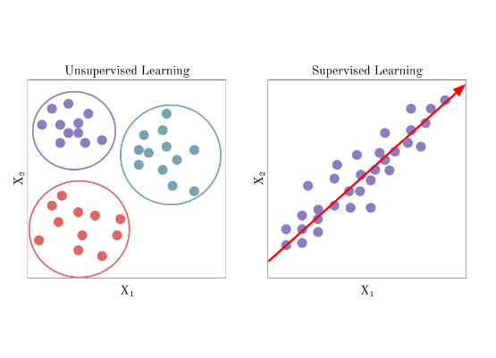
Unsupervised Learning
Finding Hidden Structure
•
Input data has no labels.
•
Goal: Discover implicit patterns, groups, or structures.
•
Key Applications: Clustering, Density Estimation, Dimensionality Reduction.

Slide 13
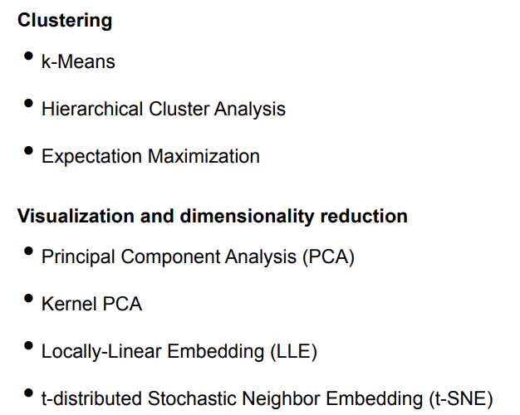
Unsupervised Learning Techniques/Algorithms

Slide 14
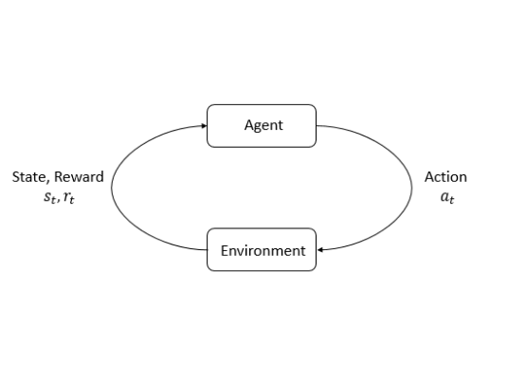
Reinforcement Learning (RL)
•
Agent interacts with Environment.
•
Selects Action → Receives Reward/Penalty.
•
Goal: Learn optimal Policy to maximize cumulative reward.
•
Challenge: Credit Assignment (delayed rewards).

Slide 15
Comparing Core ML Types
Type | Data Source | Goal | Approach
Supervised | Labeled Data | Prediction / Classification | Map Input → Output
Unsupervised | Unlabeled Data | Structure / Clustering | Discover Patterns
Reinforcement | Feedback (Reward) | Control / Policy | Trial & Error

Slide 16
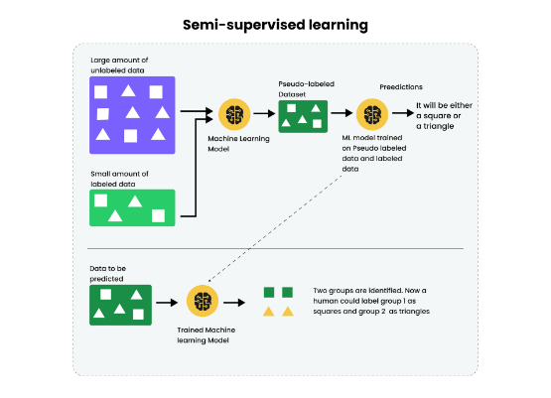
Semi-Supervised Learning
•
Combines supervised and unsupervised methods.
•
Scenario: Small amount of labeled data + Large amount of unlabeled data.
•
Method: Cluster data first, then propagate labels to neighbors.
•
Example: Google Photos face tagging.

Slide 17


Learning Taxonomy: Data Usage
Batch Learning
Online Learning
•
Offline training.
•
Incremental training.
•
Uses all available data at once.
•
Updates with single instances/mini-batches.
•
Model is static after training.
•
Adapts to changing data (concept drift).

Slide 18
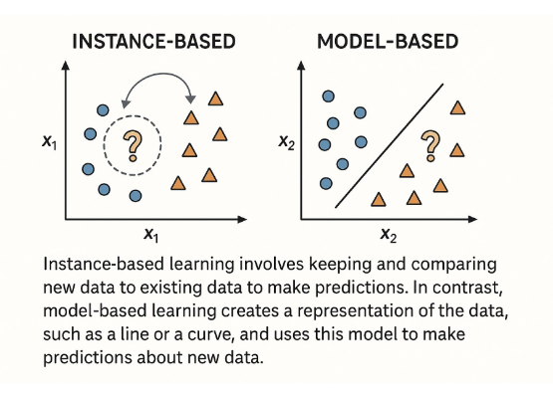
Instance-Based vs Model-Based
•
Instance-Based (Lazy): Memorizes training examples. Generalizes by comparing new data to stored points (e.g., k-NN).
•
Model-Based: Detects patterns to build a predictive function/model (e.g., Regression, NN).

Slide 19
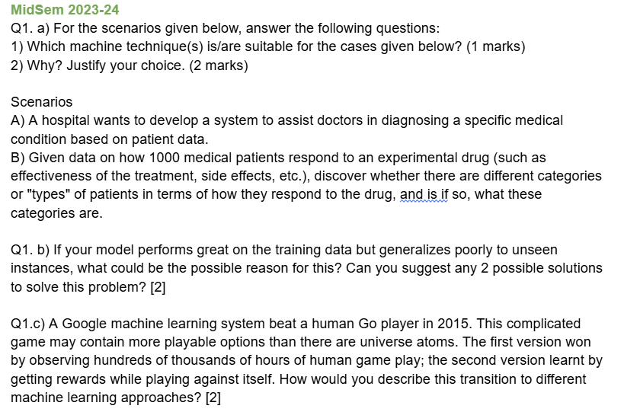
Past Papers

Slide 20
IGNORING BELOW SLIDES

Slide 21
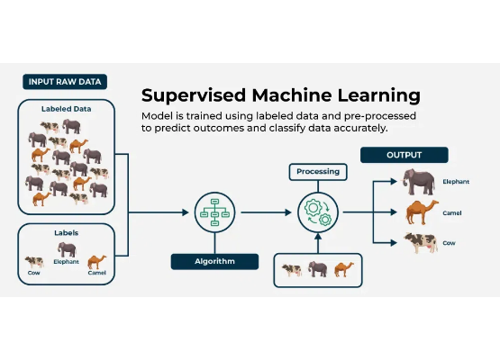

Engineering Definition (Tom Mitchell)
A program learns if its performance on Task T, measured by P, improves with Experience E.
•
Task (T): e.g., Recognizing handwritten words.
•
Performance (P): e.g., % correctly classified.
•
Experience (E): e.g., Database of labeled images.

